Slide 1



Progress in the Development of Primary (Johnson Noise) Thermometer
Notes:
Hello and welcome to an update on the progress made (since the last TEMPMEKO in 2016) towards the development of the worlds first practical Johnson noise thermometer.

Slide 2
Johnson Noise
RMS
Notes:
To make a Johnson noise thermometer, all we have to do is connected any resistance sensor to a true RMS voltmeter. The material of the sensor is unimportant. The resistor is show in blue to indicate that it is cold but the meter does not read zero since it is not at absolute zero and is therefore generating some Johnson noise. The Johnson noise is white, which means that it has the same power density at all frequencies and our voltmeter will respond to frequencies in its operating bandwidth. As we heat the resistor the meter will indicate progressively higher readings as the electrons that are within the resistor are excited into high energy states. The system is measuring the electrical noise generate by the thermally excited electrons in the resistor and as they get hotter their average speed increases thereby increasing the noise generated. The noise is directly related to the temperature of the electrons generating the noise.

Slide 3

Johnson Noise
JNTs use the Johnson-Nyquist equation
$$v_{n}= \sqrt{4kTRΔf}$$
Notes:
A Johnson noise thermometer makes use of the Johnson-Nyquist equation, which describes the relationship between the measured RMS noise signal (vn) , the Boltzmann constant (k), the true thermodynamic temperature (T), the sensor resistance (R) and the measurement bandwidth (Δf).

Slide 4

Johnson Noise
JNTs use the Johnson-Nyquist equation
$$T=\frac{1}{4k}\left\{{\frac{v_{n}^{2}}{R}}/{∆f}\right\}$$
Notes:
By measuring the RMS noise signal from a resistor over a known bandwidth and its resistance, we can determine its true thermodynamic temperature from a purely electrical measurement, and completely independently, of any property of the resistor itself and of ITS90.

Slide 5






Prior Art JNTs
$$T=\frac{1}{4k}\left\{{\frac{{v_{T}}^{2}}{R_{s}}}/{{∆f}_{1}}\right\}$$
$$To=\frac{1}{4k}\left\{{\frac{{v_{0}}^{2}}{R_{O}}}/{{∆f}_{2}}\right\}$$
$$v_{o}^{2}$$
$$v_{T}^{2}$$
$$T=T_{O}\frac{v_{T}^{2}{ R}_{O}}{v_{0}^{2} R_{s} }$$
if ${∆f}_{1}$= ${ ∆f}_{2}$
$$T=T_{O}\frac{v_{T}^{2}{ R}_{O}{ ∆f}_{2}}{v_{0}^{2} R_{s} {∆f}_{1}}$$
Notes:
Prior art systems worked by switching the measurement system (amplifiers and a correlator used to supress amplifier noise) between measuring the unknown noise from the sensor and a white noise calibration signal of known spectral power density. The ratio of the two measurements together with the known spectral power density of the calibration signal enables the sensor temperature to be determined with the key proviso that the bandwidth must be the same for the two noise measurements. This caveat is one of the factors that has so far limited the practicality of Johnson noise thermometers in industrial applications.

Slide 6



Metrosol’s JNT
Patented Internationally
$$T=\frac{{v_{T}}^{2}}{{v_{0}}^{2} } \frac{{i_{0}}^{2}R_{S}}{4 k}$$
$$v_{T}^{2}$$
$$v_{o}^{2}$$
Notes:
Our new technique (patented) involves injecting the calibration signal as a current into the measurement system, which generates a calibration voltage signal in the resistor.
The Johnson Noise and calibration signal experience EXACTLY the same frequency response. The Johnson noise and calibration signal are then separated using digital signal processing (DSP).

Slide 7
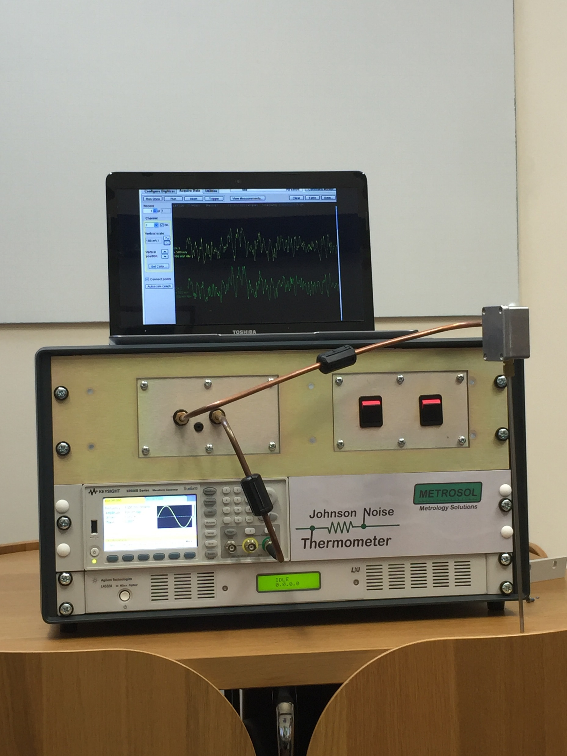
JNT1 Proof of Principle Prototype: 2016
TEMPMEKO 2016 (JNT1):
35kg & 70L
-20 to+120°C
Notes:
At the last TEMPMEKO we demonstrated the practicality of the system using a benchtop proof of principle prototype. This system was a relatively large benchtop system (35kg and 70L) and incoorporated several commercial instruments

Slide 8
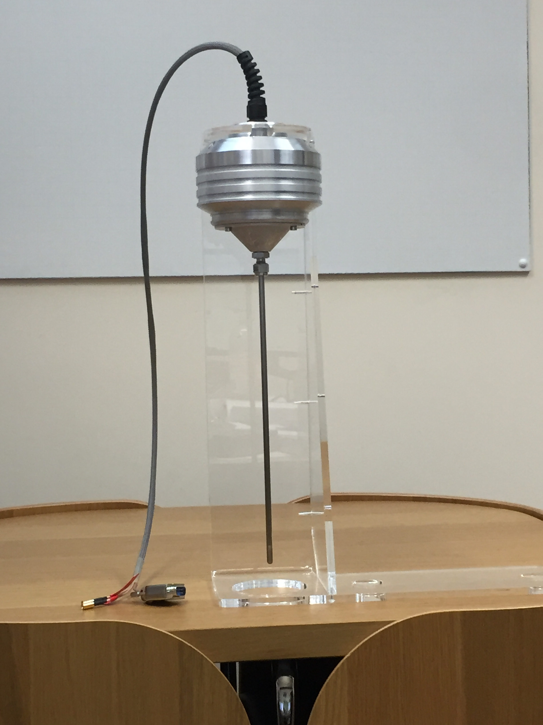
Progress of JNT2 Programme
TEMPMEKO 2019 (JNT2):
<1kg & <1L
-100 to 1,000°C
Notes:
Since 2016 we have developed our own technology to make all the measurements previously made by commercial instruments in the demonstrator in order to produce a smaller format device and improved performance. The commercial instruments we used were quite good but by tailoring the performance to our exact requirements rather than providing a general purpose product (in the commercial products) we have been able to improve performance and reduce size, weight and cost.

Slide 9
EMC (immunity to EM Interference)
Thermal (Johnson) Noise signals are very small. A change of 0.01°C at 1,000°C corresponds to a change in the (RMS) noise voltage of:
All previous attempts have failed to achieve significant immunity
Simply putting the electronics into a “screened box” is completely inadequate
Extreme EMC hardening measures are required to achieve adequate immunity
 | Bandwidth = 100kHz | Bandwidth = 1MHz
Rsense = 100Ω | 8.4nV | 26.5nV
Rsense = 5kΩ | 59.3nV | 187.5nV
Notes:
Another key area of concern and one that has led to the abandonment of several previous attempts to make a practical Johnson noise thermometer for industrial applications is EMC (electro-magnetic compatibility), specifically immunity to external noise. The signals we are measuring are extremely small, despite the fact that our system is able to use a high sense resistance and bandwidth than prior art. In our system we have an RMS signal of just under 200nV but this is spread over a 1MHz bandwidth so could easily be contaminated by external electromagnetic interference. Accepted orthodoxy on preventing signal from effecting electronics is to place them in a screened box, but this is completely inadequate for the small signals involved in JNT.

Slide 10
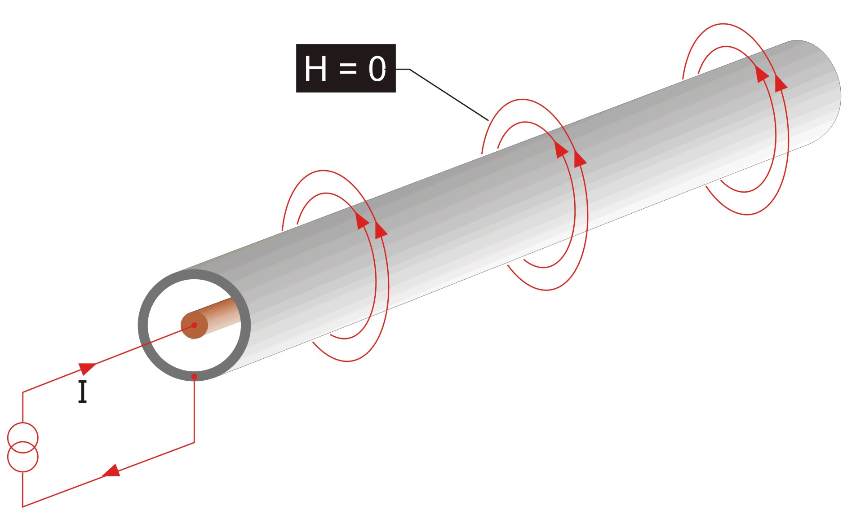
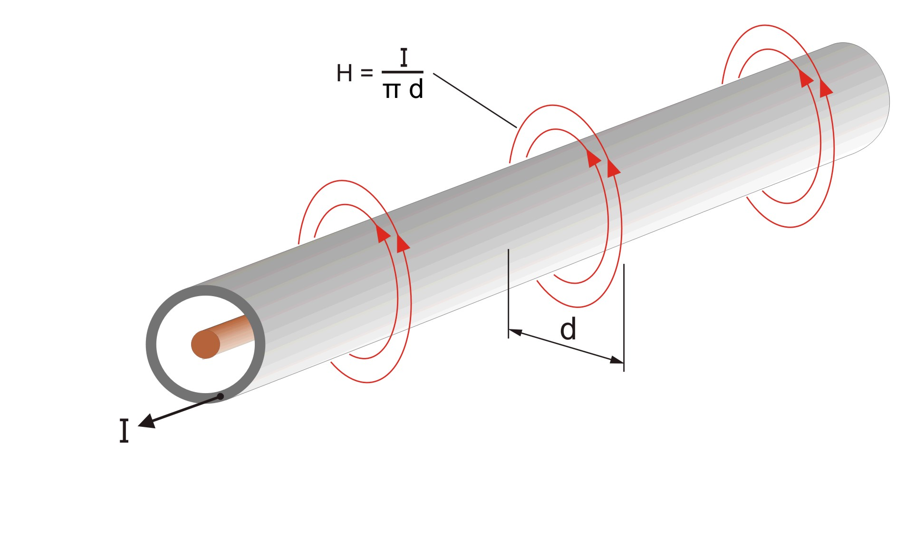
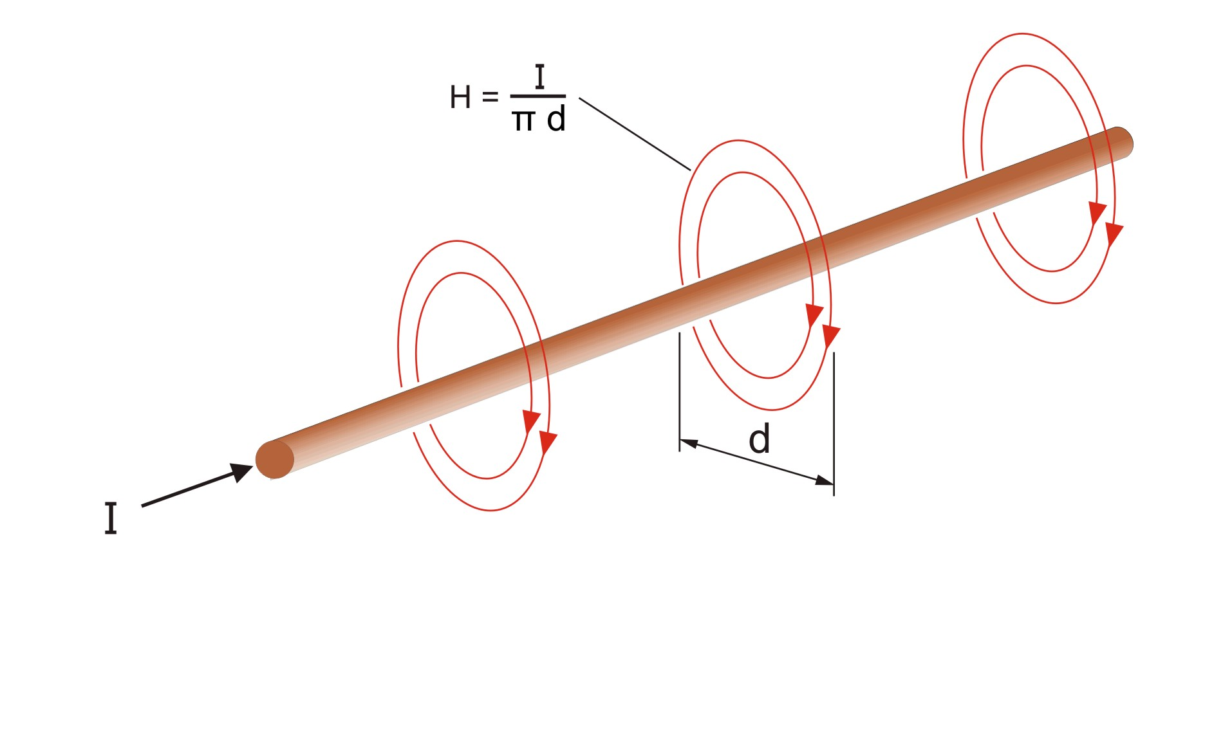
Full Coaxial Design for EMC
Notes:
Instead we need to use a fully co-axial design. The benefits of this approach can be seen by considering a coaxial cable. If we pass a signal down the centre core and the return current passes through the outer screen the external field will be zero – the magnetic field from the outgoing and return signal completely cancel each other out outside of the cable. This means that there will be no emissions from the coaxial system… none at all. Since the coaxial system cannot radiate, neither can it be effected by any external electromagnetic fields.

Slide 11
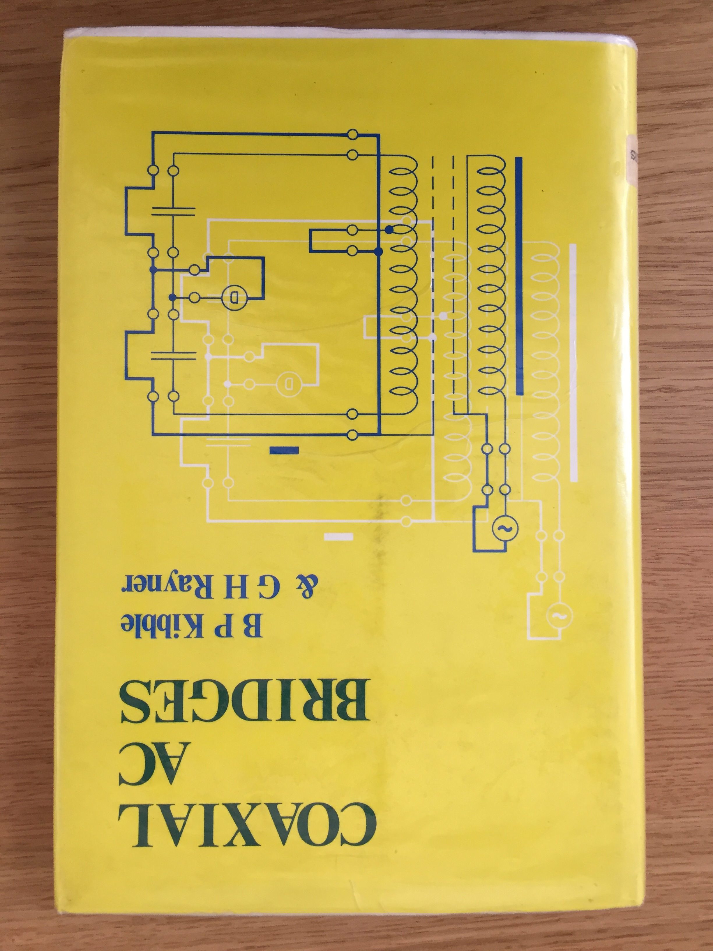
Full Coaxial Design for EMC
Notes:
This technique has been known for many years and most electronics engineers will have come across the concept as undergraduates, perhaps as part of a course on Maxwell’s equations, wave propagation and transmission lines. However, the idea of simply using a screened enclosure seems to take over from a more thorough understanding of the mechanisms by which unwanted signals can couple into our measurement systems. The Coaxial AC Bridges book by Kibble ad Rayner provides a thorough explanation of the theory and practice of making electronic system completely immune to electrical interference. These practices were adopted in our JNT design in order to achieve the high level of EMC required.

Slide 12
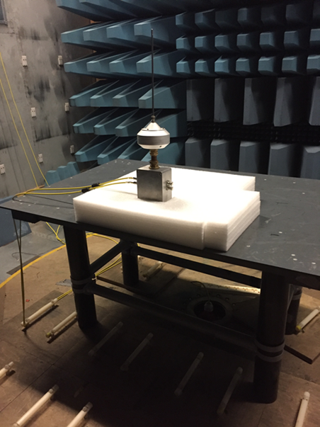
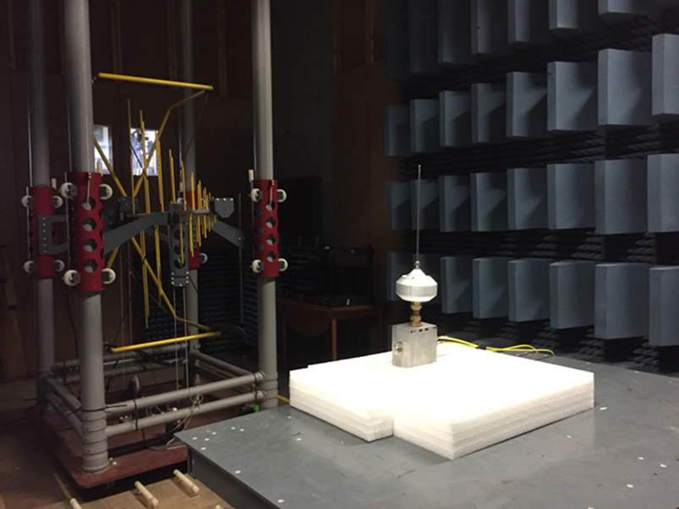
Immunity Tests at Test Laboratory
8th May 2018: Passed EMC tests to EN61000-4 & EN55011:2009
Tested to (harshest) Heavy Industrial level of immunity (10Vm⁻¹)
Notes:
We tested our new prototype for EMC at an accredited calibration laboratory and were pleased to find that there was no measurable affect on the output from the thermometer even at the highest applied field strengths available of 10V/m, which simulates a heavy industrial electrical environment.

Slide 13
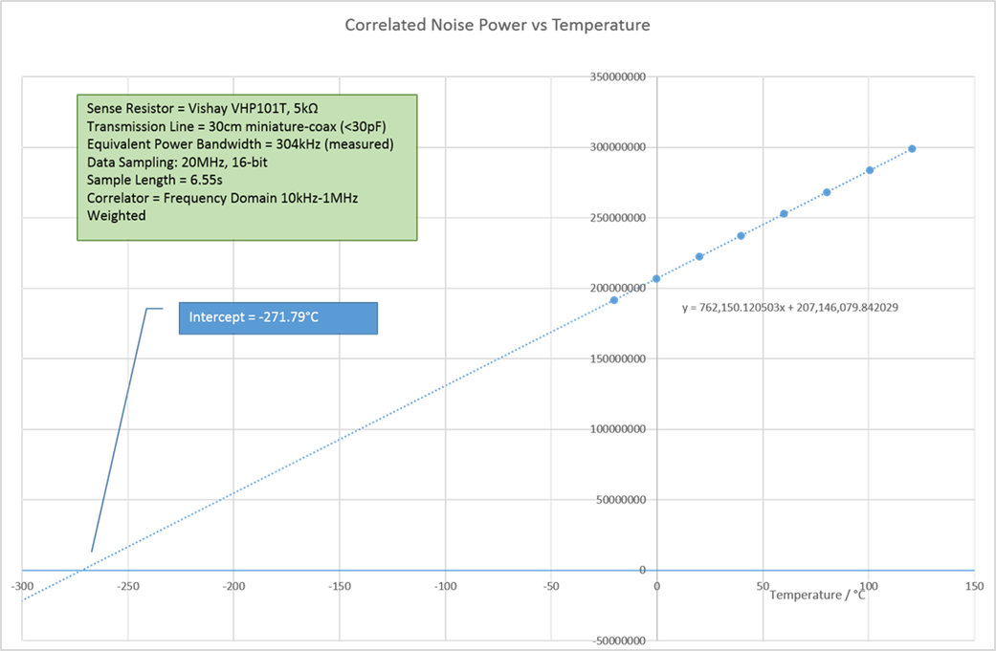
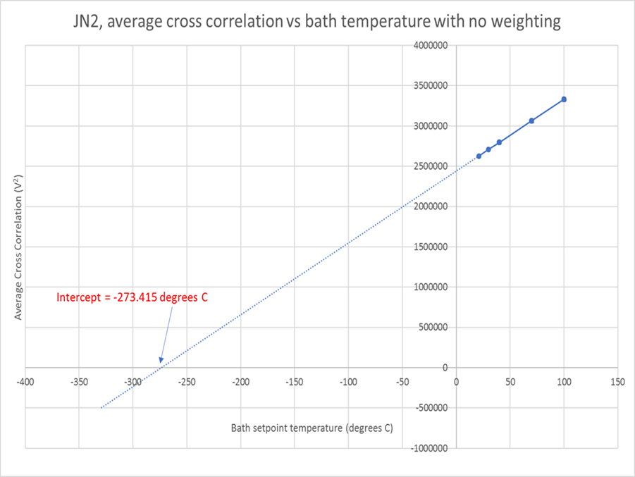
JNT2 Performance Improvements

Slide 14
JNT:JNT2 Performance Comparison
 | Original JNT Project | JNT2 Project
Zero Offset | -1.36°C | +0.26°C
Noise (standard deviation for 6s samples) | 0.14°C | 0.24°C ^{[1]}
EMC Performance: Immunity Emmisions | Normal Lab (Unknown) | Excellent10Vm⁻¹ (heavy industrial limit) Below measurement limits
Note 1: The improved design has better accuracy indicated by the reduced zero offset. Compromises necessary to improve some performance improvements were expected to incur to an acceptable 20% increase in the measurement noise. Actual measurement showed measurement noise increasing by 70%. This is being investigated to find the cause and solution so as to optimise the design.
World First: JNT Capable of working in electrically noisy environment

Slide 15
Why a Johnson Noise Thermometer?
It’s a primary thermometer, so:
It’s completely insensitive to the condition of the sensor
So… it doesn’t drift
Its calibration is traceable to electrical standards and not artefacts
Calibration will be much quicker (& so cheaper thermometers) since you only need to calibrate the electronics and not the sensor
Above 660°C it could replace noble metal thermocouples
Below 660°C it could be used to check sealed fixed point cells
It is a practical thermometer using the new Kelvin unit
Notes:
The benefits of a Johnson noise thermometer stem from the fact that it is a primary thermometer. Current thermometers (thermocouples, platinum resistance thermometers and thermocouples) are all secondary thermometers so do not measure temperature directly. Instead they measure a property of the sensor that is affected by temperature so that by measuring the property temperature might be inferred. This relies on the relationship between the property and temperature remaining unchanged. Changes in the sensor (contamination, grain structure, oxidation state etc.), particularly in harsh environments, therefore lead to errors in the reported reading… drift!
A Johnson noise thermometer is a primary thermometer in which the measured properties exploit a fundamental physical law that cannot change, thereby eliminating drift. A Johnson noise thermometer is completely unaffected by the condition of the sensor so will not drift.
Additionally, its calibration is traceable to electrical rather than temperature standards (ITS-90) and electrical calibrations are easier, faster and cheaper to perform than temperature calibrations.
In industrial applications a Johnson noise thermometer offers the benefit of long-term drift free performance, which is especially useful at high temperatures in harsh environments. In metrology applications it provides a drift-free realisation of the new Kelvin unit.

Slide 16
JNT2 Programme – What Next
Thank you for coming, have a safe journey home… see you at the next TEMPMEKO!
Fully engineered production standard instrument by:
29th September 2020 (currently running I week behind the plan)
You can:
See existing (working) prototype on the Isotech stand here at Tempmeko
Follow our progress on:
Website: www.johnson-noise-thermometer.com
Facebook page: www.facebook.com/johnsonnoisethermometer
Notes:
Our target is to have a fully engineered prototype of the complete Johnson noise thermometer by the end of 2020. You can follow the progress of the team on our dedicated website of Facebook page, though unlike our teenage children we only post updates when we have real news!

