Slide 1

Development of a practical Johnson Noise Thermometer (JNT): latest progress A joint project between Metrosol and NPL Paul Bramley - Metrosol Limited
Notes:
In previous presentations to this audience I have focussed on the “how” of the technology… how it worked. Today I will provide an update on our progress and the emphasis will be more on the “why”… what benefits does a Johnson noise thermometer provide to the industrial measurement community.

Slide 2

1. Menu for today
What is Johnson noise?
Making a Johnson noise thermometer?
Why use a JNT – what are the benefits?
Progress towards the worlds first practical JNT for use in harsh industrial environments
Next steps… do you want to join us?
Notes:
These are the topics covered in this presentation.

Slide 3
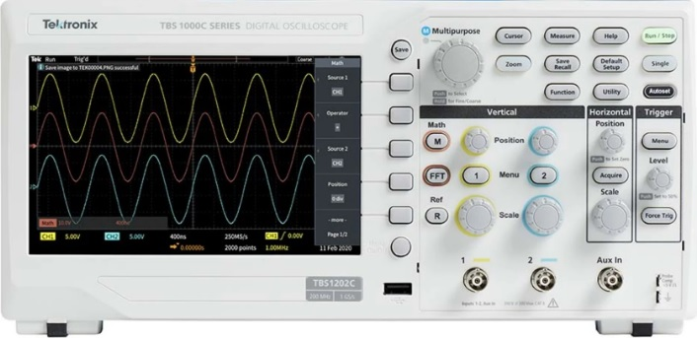
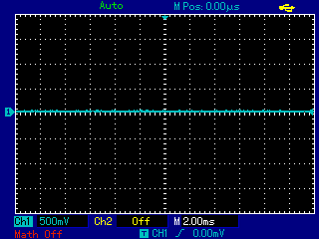
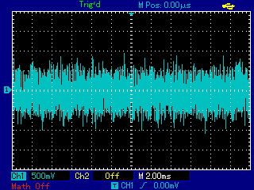
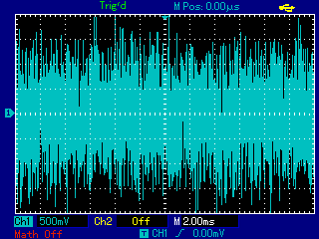

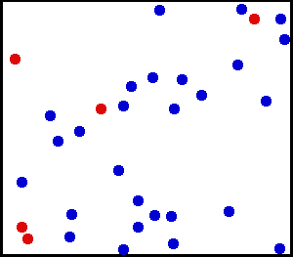
1. What Is Johnson Noise?
Notes:
Let’s start by describing the origins of Johnson noise for those who have not come across it before. We will do so by conducting a synthesised experiment.
Here you see an oscilloscope connected to a high gain amplifier, which is required since we are looking for are extremely small signals. You can see that there is initially no signal on the oscilloscope.
On the left we have a small film resistor. This inexpensive part is exactly the type used in our first prototype since any resistor compatible with the environment will work. There is nothing special about the sensor. When we connect it to the amplified we see gaussian (white) noise on the oscilloscope, this is Johnson noise.
If we could look “inside” the resistor we would see a “cloud” of electrons contained within the potential well formed by the metal ions of the resistor. These electrically charged particles are thermally excited so are moving around rapidly. On average they are uniformly distributed throughout the resistor but because they are moving randomly they are sometimes nearer one end of the resistor than the other thereby making it slight more negative than the other end. This is the original of the Johnson noise signal.
Importantly for us, if we were to heat up the resistor this noise increases as the electrons become more thermally excited. The Johnson noise is a measure of the thermal excitation of the cloud of electrons, which is completely independent of the state of the sensor.

Slide 4

2. Making a Johnson Noise Thermometer
JNTs use the Johnson-Nyquist equation
$$v_{n}= \sqrt{4kTRΔf}$$
Notes:
We can use this effect to make a thermometer by employing the Johnson-Nyquist equation which states that the measured RMS noise (vn) is the square root of four times the Boltzmann constant (k) time the thermodynamic temperature of the sensor resistance (T) time its measured resistance (R) and the measurement bandwidth (Δf).

Slide 5

2. Making a Johnson Noise Thermometer
JNTs use the Johnson-Nyquist equation
$$T=\frac{1}{4k}\left\{\frac{v_{n}^{2}}{R∆f}\right\}$$
Notes:
By rearranging this equation we see that if we measure just three parameters we can determine the true thermodynamic temperature of the sensor.
If we determine the mean squared voltage and divide it by the resistance and measurement bandwidth we get the spectral power density of the Johnson noise figure in the curly brackets. Scaling this by the reciprocal of four times the Boltzmann constant gives us the thermodynamic temperature of the sensor resistance.

Slide 6
3. The benefits of a JNT
Johnson Noise Thermometers do not drift (the electronics can!)
Places where replacement is a problem:
Space
Nuclear (power & waste storage)
Extended calibration intervals (lower cost):
Nuclear
Petrochemical
Metrology (standards)
Improved safety or process yield where drift is a problem
Power generation (nuclear, conventional thermal, aerospace/jet engines)
Aerospace – turbine blade manufacture
Ideal replacement for thermocouples in applications where their drift is a problem
Traceable to electrical standards – faster (lower cost) calibration
Notes:
The main benefit of a Johnson noise thermometer is that it does not drift, indeed it cannot drift since it is based on a fundamental and therefore unchanging physical law. There are other primary thermometry techniques, but JNT is the only one where all the required properties can by measured in situ.
There is an important caveat: any error in the measurement of the three required parameters will, of course, lead to measurement errors. The electronics therefore have to be suitably accurate and stable. This is not a problem as we are accustomed to producing highly accurate and stable measurement electronics. The drift we see in current electronic thermometers is invariably the result of changes in the sensor and not drift in the electronics.
This drift free performance provides a real benefit in situations where drift in current technologies causes problems. There are situations where it is difficult or even impossible to recalibrate thermometers, such as in space applications or nuclear power generation and waste storage. The extended calibration intervals that JNT offers provide benefits (lower cost) in applications in the nuclear industry, petrochemical (where they have a large number of sensors) and temperature metrology. It also provides safety and process improvements in applications where temperature measurement is critical, such as thermal power generation and in the manufacture of single crystal turbine blades where precise annealing temperatures are essential.
Another benefit is that its calibration is traceable to electrical standards. Such calibrations are easier, faster and cheaper than temperature calibrations.

Slide 7
4. Progress Towards a Practical JNT
2014: NPL proposed the joint development of a JNT to meet increasing demand for more stable thermometers in harsh industrial environments
Best prior art was Brixy (1996):
Notes:
We started this programme in 2014 as a result of a suggestion from NPL who were getting an increasing number of requests from industry for better thermometers for use in harsh environments. NPL suggested that we might want to work with them on the development of a Johnson noise thermometer to solve this growing problem. At the time the best prior art was work done by Brixy, though this never led to a commercial product. This graphs is from his work and shows a sensor that measures temperature from a hybrid thermometer used both as a thermocouple and a Johnson noise thermometer.
The readings as a thermocouple can be seen drifting down (the dangerous direction) whereas the measurements based on Johnson noise are entirely stable even though it is clear that the sensor is becoming increasingly contaminated.

Slide 8
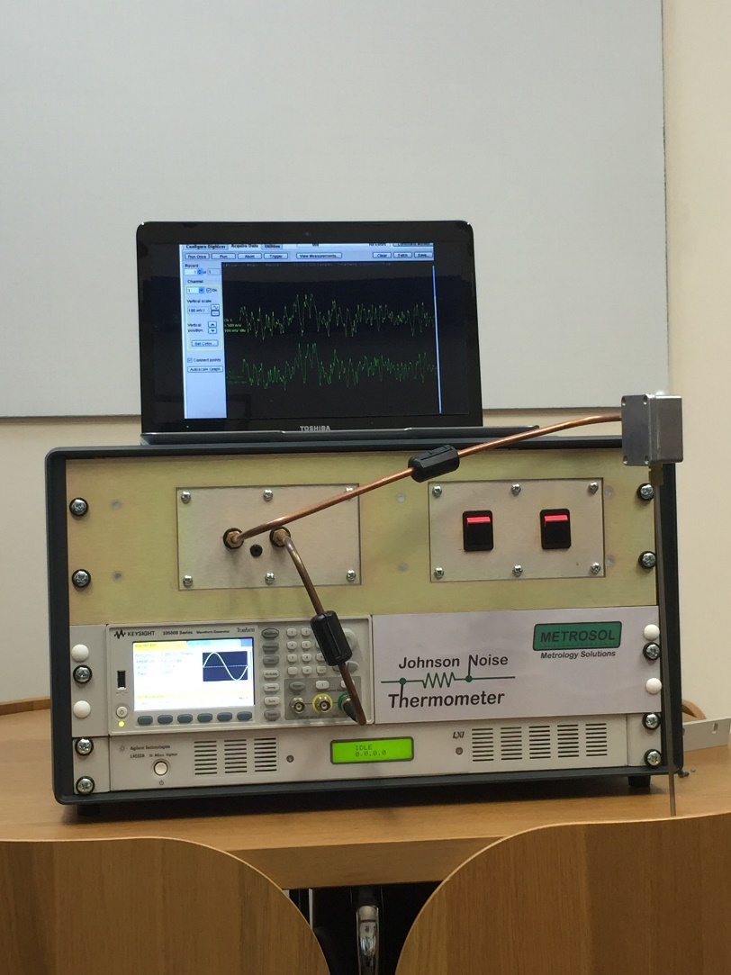
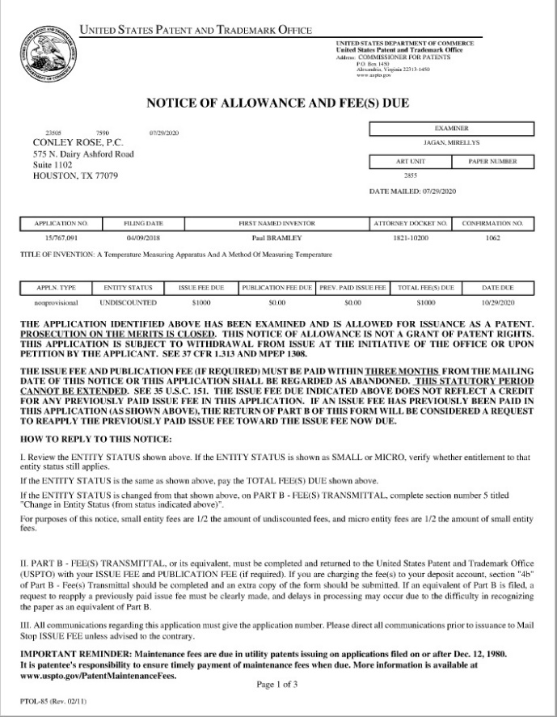
4. Project “JNT1”
JNT1 project (Oct 2015 – Mar2017), 2 outputs:
New concept in JNT (patented)
Proof-of-principle prototype
35kg & 70L
-20 to+120°C
Notes:
Our first JNT project was essentially a feasibility study. In researching the history of JNT, we realised that there was a basic problem with all the previous attempts to make a practical Johnson noise thermometer. We therefore came up with a new technique for measuring Johnson noise that resolved this problem and the “outputs” from this programme were patents on the new technique and a proof of principle prototype that demonstrated the practicality of this novel JNT technology.

Slide 9
4. The New Technique:
Prior Art
New Technique
Notes:
Before proceeding let’s take a quick look at this new technique. For more details please refer to the papers we have previously published on this technology.
Prior art systems used a correlator in which the signal to be measured is amplified by two amplifiers and then correlated. This suppresses the noise from the amplifiers, which is comparable to the signals we are measuring and would otherwise provide a variable offset in the measurement with its associated uncertainty. The approach was essentially to switch the measurement system (amplifiers and correlator) between measuring the signal from the sense resistor and a reference noise signal of known spectral power density. This problem with this approach is that the connection from the sensor to the electronics (along the probe plus any cabling) provides a low pass filter for the Johnson noise signal due to capacitance. This is not shared with the reference signal so leads to measurement errors. In order to mitigate this problem prior art system limited the working bandwidth (to typically 100kHz) and were susceptible to drift if the frequency response changed.
With our technique, we inject the calibration/reference signal directly into the measurement system as a current. This then generates a calibration voltage signal across the sense resistor which experiences the same frequency response as the Johnson noise we are trying to measure.

Slide 10
4. Project “JNT2”
JNT2 project (Oct 2017 – Dec 2020)
Turn this new technology into a fully engineered technology capable to realising a practical JNT
Develop all the required technologies
Achieve EMC: make it work in a harsh environment
Reduce size (1L & 1kg)
Work over a range of interest (0-1000°C)
Notes:
The original demonstrator from 2016 was a 19 inch rack (35kg and 70L) incorporating commercial instruments to make the measurements. The next JNT project ran from 2017 to 2020 and aimed to develop all the technology required to make the measurements in a smaller format (1kg & 1L).
We also had to develop a probe that would operate at a usefully high temperature and a system that was capable of working in a “real world”, electrically noise environment. External noise polluting the measurement signals had been a fatal problem with several previous attempts to make a practical JNT.

Slide 11
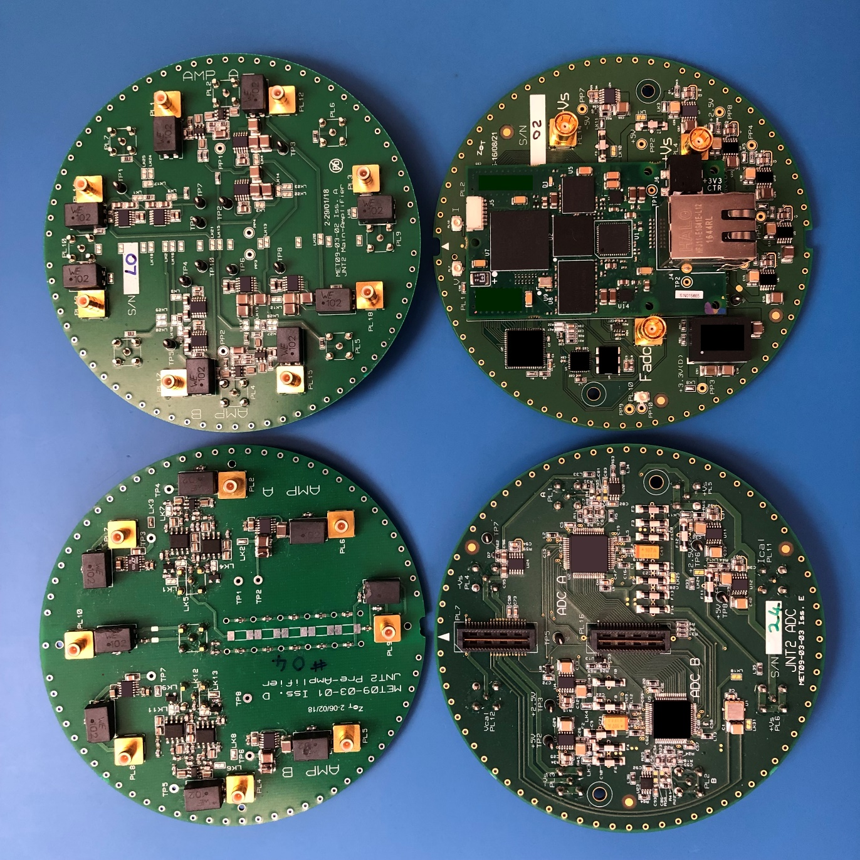
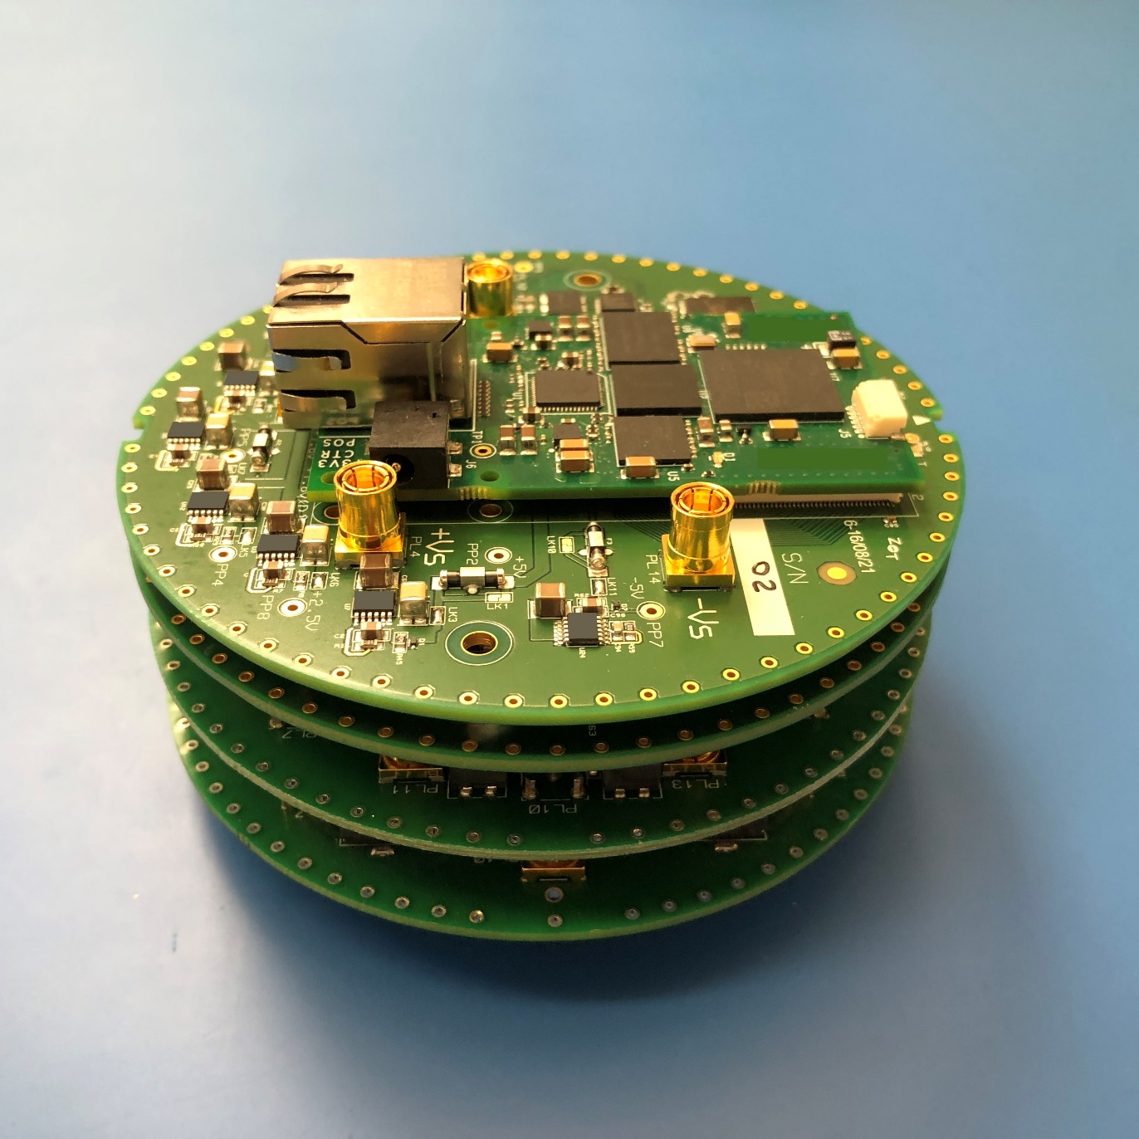
4. JNT2: Essential Circuits Designed
Notes:
Here are the subsystems for our Johnson noise thermometer. The circular PCBs stack and clip together then go into the sensor housing.
These double sided, multi-layer PCBs replace all the commercial instruments in the demonstrator and offer not only smaller size and power consumption but also better performance since they are tailored to the specific requirements of the measurements rather than being general purpose instruments.

Slide 12
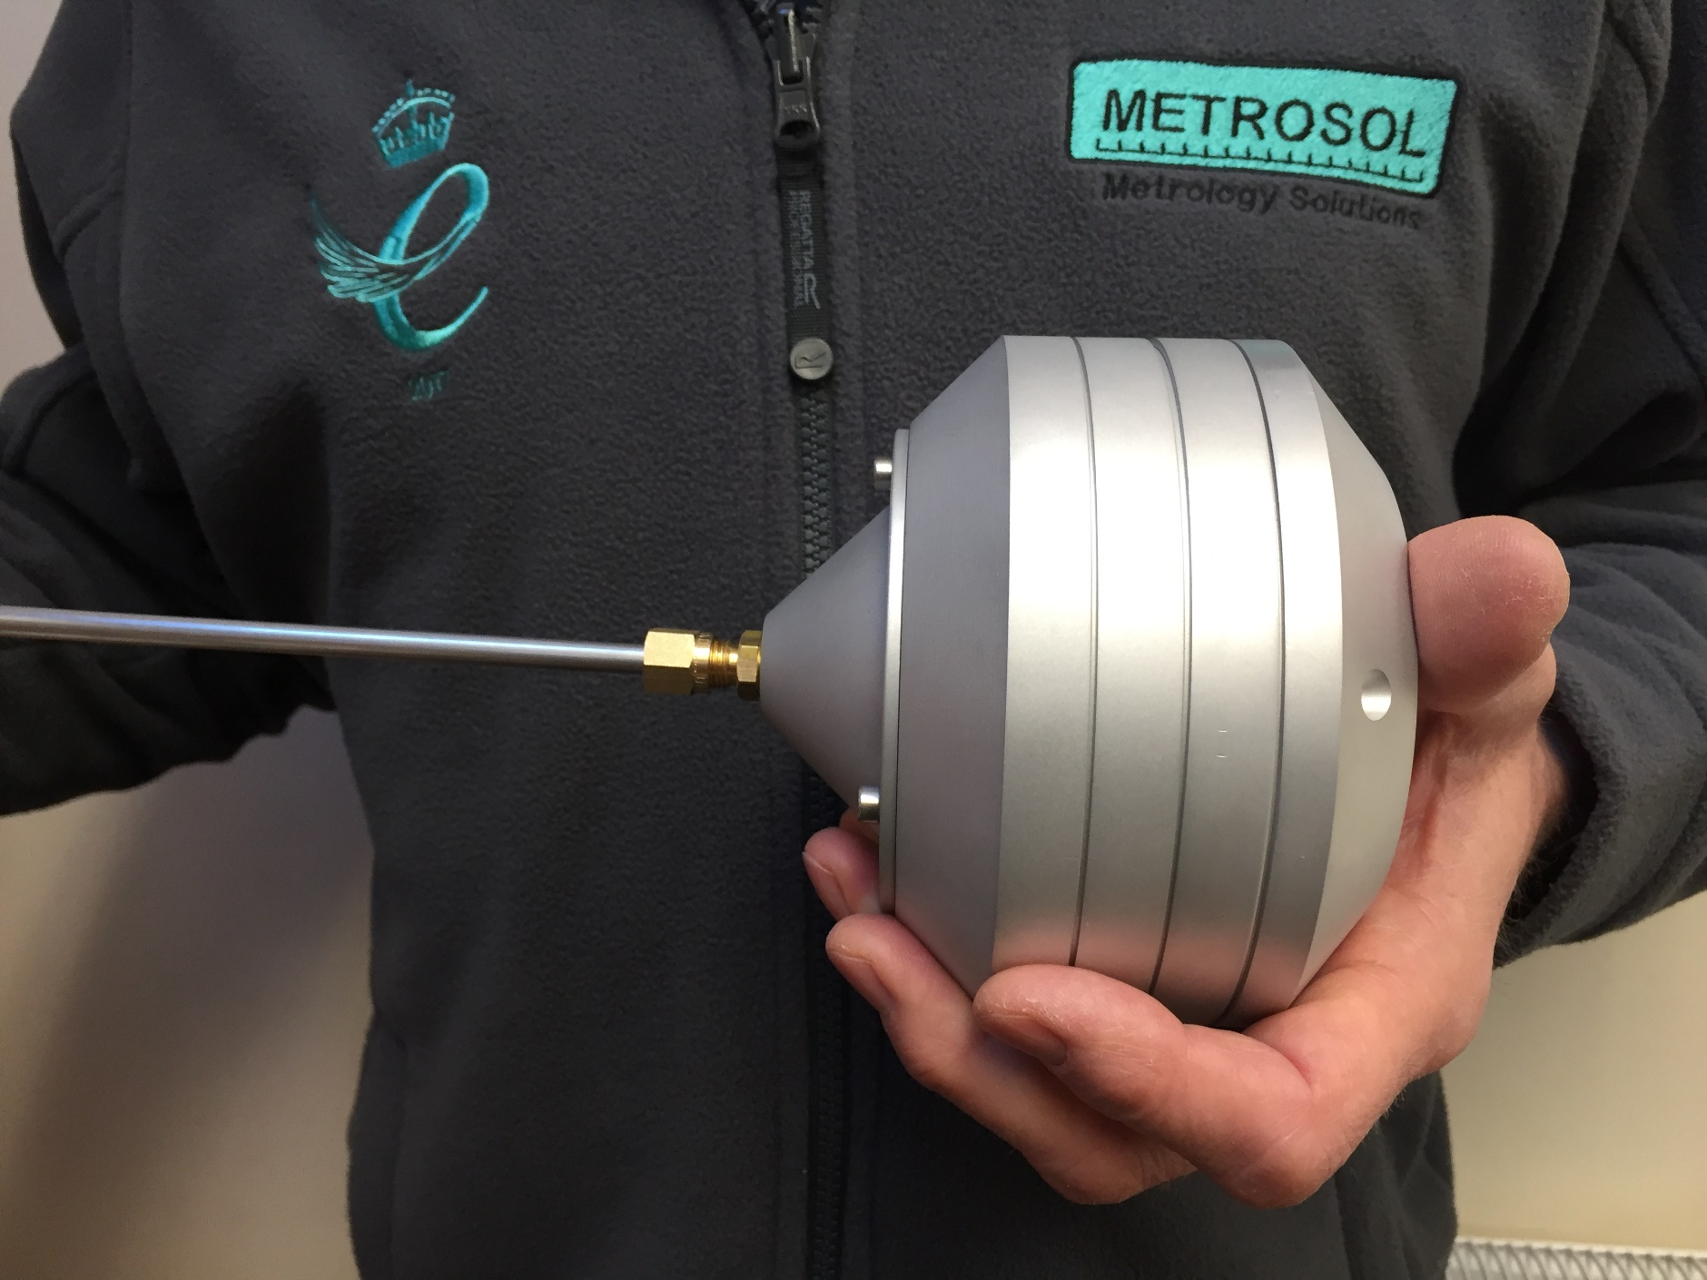
4. JNT2: Weight Loss Programme
Notes:
Together with the housing, the electronics and probe provide and system that is suitable for use in a real-world environment.

Slide 13
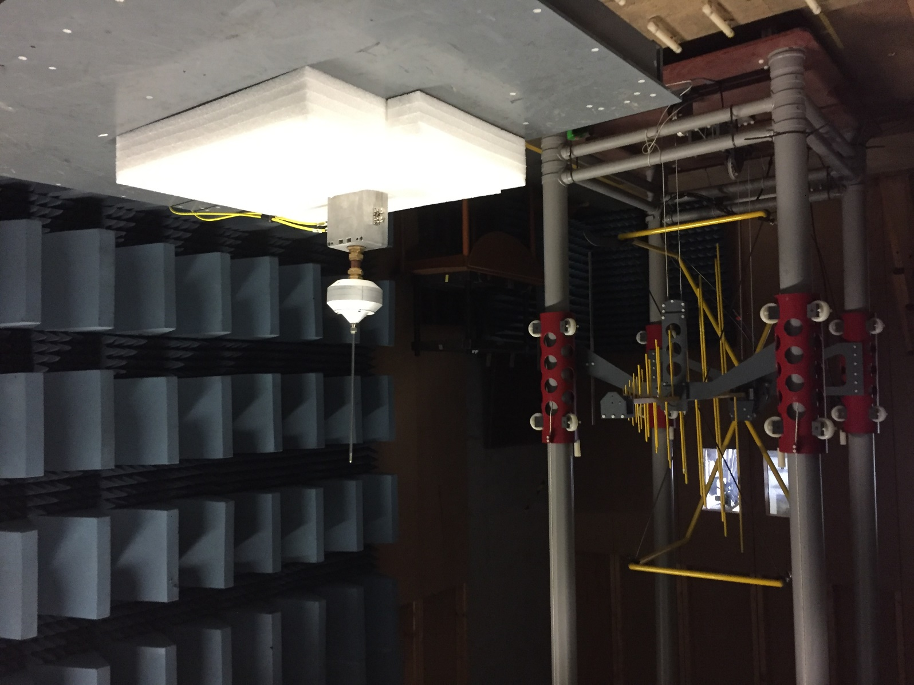
4. JNT2: EMC Achieved (a key milestone)
10Vm⁻¹
^{Heavy Industrial Limit}
Notes:
The new prototype was tested in an accredited EMC test laboratory with the highest field strength available (10V/m). This simulates a “heavy industrial” electrical environment. The tests showed no measurable effect on the measurement made by the Johnson noise thermometer. As far as we know, this is the first JNT that has been shown to work in anything like a realistic electromagnetic environment. Most previous attempts have failed to work even in a benign laboratory environment, never mind a heavy industrial one.

Slide 14
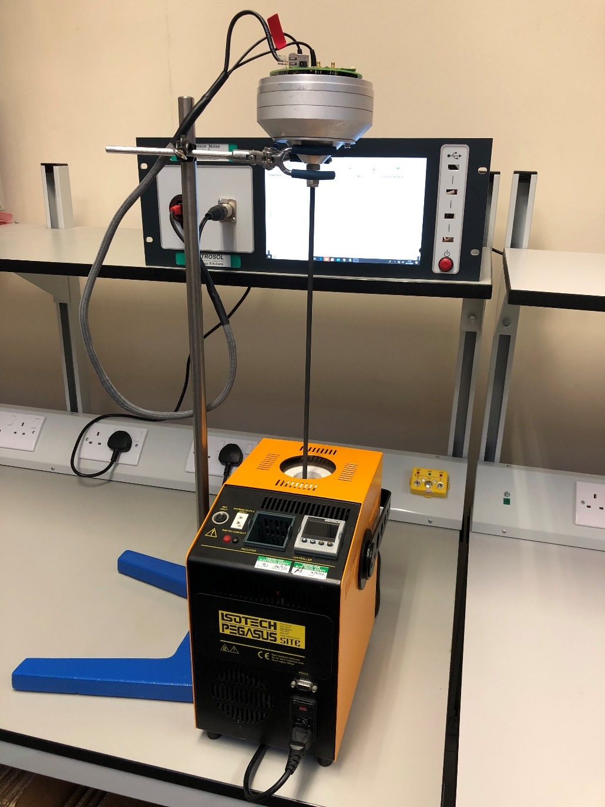
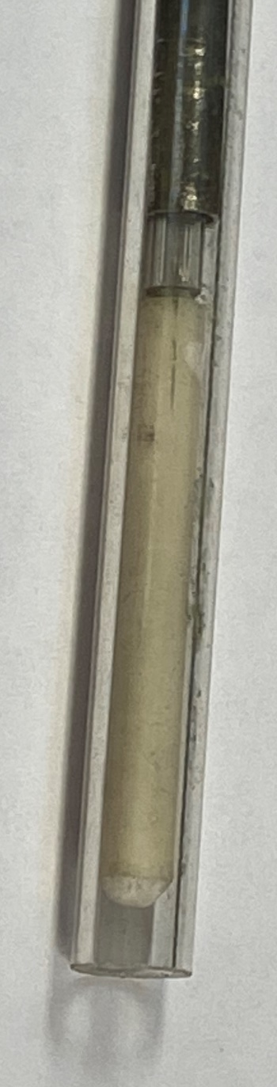
4. Project “JNT2”
Standard Deviations:
0.36°C @ 20°C
1.1°C @ 1,000°C
Rice’s Equation Limit:
0.12°C @ 20°C
0.53°C @ 1,000°C
(for 1MHz BW & 5.9s)
Notes:
The next step was to develop a thermometer probe capable of working at higher temperatures. The centre image shows the sensor mounted at the end of a coaxial connection. The assembly was then inserted into an Inconel sheath.
We tested the system in a furnace (picture on right) and found that the results showed standard deviations of 0.36°C near ambient and 1.1°C at 1,000°C. Our system has a bandwidth of 1MHz (the highest for any JNT) and samples every 5.9s. These result compare well with the fundamental limit for noise thermometry given by Rice’s equation, being less than twice this fundamental limit for this first generation realisation.
Noise thermometry is drift free but does have a fundamental limit on the uncertainty is can achieve as dictated by Rice’s equation. Stated qualitatively, this says that if we are determining the value of a random noise signal from a finite sample there will be uncertainty in our measurement… we don’t know what this random signal is about to do next! The more signal we have the lower this uncertainty. More can mean more time or more bandwidth. Our 1MHz bandwidth means we are able to make useful measurements in a timeframe that is useful in industrial applications. Prior art systems with limited bandwidths (typically 100kHz) need many minutes to make measurements with the same uncertainty making them of limited use in industrial applications.

Slide 15


4. Project “JNT3”
JNT3 project (Jan 2021 – Dec 2021)
Characterise and optimise all parts of the measurement system to create a realistic specification & uncertainty budget
ADC
DAC
Calibration signal injection network
Notes:
The current JNT project aims to characterise the performance of all the sub-systems in order to determine a specification and uncertainty budget for the first product. We are also taking the opportunity to optimise the performance where we discover that can be done.
We have already completed work on the ADC and DAC system and will soon turn our attention to the networks used to inject the calibration/reference signal produced by the DAC into the measurement system. This injection has to be done without affecting the spectral content of the signal, Since we are working up to 1MHz and are targeting and accuracy of <0.01% this is in itself quite challenging to both achieve and demonstrate that is have been achieved.

Slide 16
5. Project “JNT4”
Anticipated JNT4 project (Jan 2022+)
By end of 2021 we will have all the technology to create a practical JNT for us in harsh industrial environments
What sort of JNT do we design first? (Metrology/industrial, temperature range, features, interface: Ethernet, USB, RS232, HART, Fieldbus, 4-20mA)
If you are interested in engaging in order to influence the first JNT contact paul.bramley@metrosol.co.uk
Notes:
Our aim is to have the current work on characterising and optimising the technology completed by the end of 2021. The next step will be to work on the development of the first commercial product using this new technology.
We now have to decide on the features and specification of this product. This includes things such as size, weight, power consumption, operating range and interface. We are interested in talking to and working with anyone who thinks that this technology might be useful in their specific industry and application so that we come up with something that meets the needs of potential users. This is a new technology that has the potential to revolutionise the measurement of temperature in harsh and demanding environments. Being a new technology in a new (for us) market we have no preconceived ideas about what this product should look like so would like to work with anyone interested in joining us on this journey.

Slide 17
www.johnson-noise-thermometer.com
https://www.facebook.com/johnsonnoisethermometer/
paul.bramley@metrosol.co.uk

