Slide 1
An innovation project by ……
A Practical Johnson Noise
Thermometer
Metrosol Limited & NPL
Notes:
Hello and welcome to this presentation on the worlds first practical Johnson noise thermometer. Johnson noise has for many years been used by metrologists as a means of measuring temperature but so far these devices have been limited to expensive, room sized experiments whose purpose was to determine true thermodynamic in order to ensure that our practical temperature scales such as the Kelvin, Celsius or Fahrenheit scales closely match the thermodynamic definition of temperature. The great advantage of Johnson noise thermometers is that the signal they measure is fundamentally linked to the true thermodynamic temperature of the thermometer’s sensor and so are incapable of drift.

Slide 2

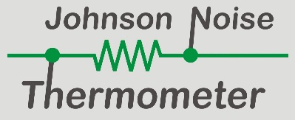
The Need for a Better Thermometer
“We don’t measure temperature with a thermometer↑”
Notes:
We don’t measure temperature with a thermometer. We measure some property of a sensor that is affected by temperature. We then relate that to the thermodynamic temperature of the sensor through a process of calibration and ITS 90 (The International Temperature Scale of 1990). This enables us to determine the temperature of the sensor and therefore of the system to which it is thermally connected.

Slide 3
Conventional Thermometers
Things other than
Temperature can affect
this property
Measure property affected by temperature
Calibration
Temperature scale
ITS-90
True thermodynamic temperature
Notes:
The process is shown here. We measured some property of the sensor in the thermometer, perhaps thermal EMF or resistance. We then relate that to a temperature scale such as the Kelvin scale by a process of calibration. This might be a calibration of the particular thermometer or just a generic calibration using the know typical characteristics of the thermometer type to relate the measurement to the temperature scale. It is then the latest agreed international temperature scale ITS90 that relates this scale to the best known value of the true thermodynamic temperature of the sensor.

Slide 4
Johnson Noise Thermometers
Measure Johnson Noise
Fundamental
Equation
True thermodynamic temperature
Notes:
In a Johnson noise thermometer, the measured noise is linked directly to the true thermodynamic temperature of the sensor by a fundamental equation. It is therefore incapable of error or drift.

Slide 5
Using Johnson Noise to Make a Thermometer
RMS
Notes:
Let’s see this in operation. Here is how we make a Johnson noise thermometer. Essentially all we have to do is connected any resistance sensor to a true RMS voltmeter. The material of the sensor is unimportant. The resistor is show in blue to indicate that it is cold but the meter does not read zero since it is not an absolute zero and is therefore generating some Johnson noise. The Johnson noise is white, which means that it has the same power density at all frequencies and our voltmeter will respond to frequencies in its operating bandwidth. As we heat the resistor the meter will indicate progressively higher readings as the electrons that are within the resistor are excited into high energy states. The system is measuring the electrical noise generate by the thermally excited electrons in the resistor and as they get hotter their average speed increases thereby increasing the noise generated. The noise is directly related to the temperature of the electrons generating the noise.

Slide 6

The Johnson-Nyquist Equation
$$V_{n}=\sqrt{4kTR∆f}$$
$V_{n}$ = the RMS voltage
$k$ = Botzmann’s constant
$T$ = the thermodynamic temperature of the resistor
$R$ = the resistance of the resistor
$∆f$= the measurement bandwidth
Problems:
$V_{n}$ extremely small (at limits of measurement)
$∆f$ hard to define/determine
An innovation project by ……
Notes:
The Johnson-Nyquist equation relates a measurement of the true RMS noise produced by a resistor (Vn) to its true thermodynamic temperature T, its resistance R and the measurement bandwidth ΔF.

Slide 7
The Johnson-Nyquist Equation
$$T=\frac{1}{4k} \left\{{\frac{V_{n}^{2}}{R}}/{∆f}\right\}$$
$V_{n}$ = the RMS voltage
$k$ = Botzmann’s constant
$T$ = the thermodynamic temperature of the resistor
$R$ = the resistance of the resistor
$∆f$= the measurement bandwidth
Problems:
$V_{n}$ extremely small (at limits of measurement)
$∆f$ hard to define/determine
An innovation project by ……
Notes:
By measuring the RMS noise signal from a resistor over a known bandwidth and its resistance, we can determine its true thermodynamic temperature from a purely electrical measurement, and completely independently, of any property of the resistor itself and of ITS90.
The main problem is that the signal levels involved are extremely small, approaching the limits of measurement. Prior art Johnson Noise Thermometers use 100 ohm sense resistance and 100 kHz bandwidth. At 20°C, the noise signal would then be 1.27 μV RMS. Measuring to ±0.3 K means measuring this noise to ±1.27 nV, which is at the very limits of measurement.

Slide 8
Prior Art Johnson Noise Thermometer
Amplifiers A & B amplify the same signal from the sense resistor but add their own noise
The correlator supresses uncorrelated noise and detects only the signal common to both channels i.e. the sensor’s Johnson noise
This allows us to measure the extremely small Johnson noise signal provided the correlation time is sufficiently long
An innovation project by ……
Notes:
The 2 amplified signals (A and B) from the resistor contain the Johnson noise we want to measure, plus unwanted noise from the amplifiers.
The correlator supresses uncorrelated noise from the 2 amplifiers, and determines the signal common to both channels, (the Johnson Noise).

Slide 9
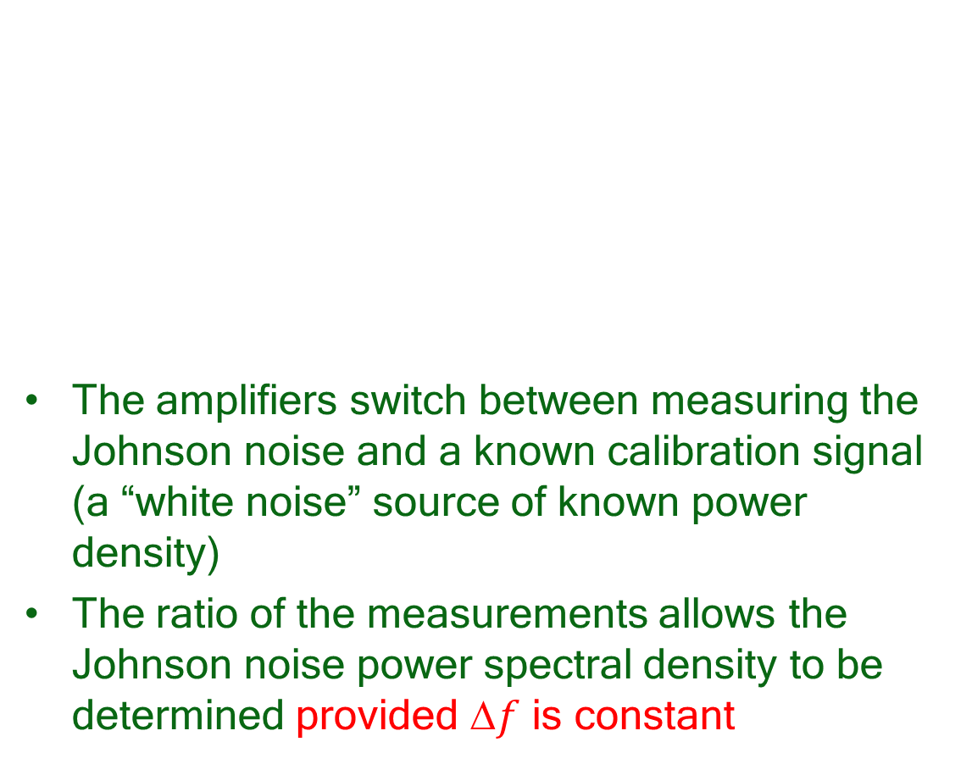
Prior Art Johnson Noise Thermometer
The amplifiers switch between measuring the Johnson noise and a known calibration signal (a “white noise” source of known power density)
The ratio of the measurements allows the Johnson noise power spectral density to be determined provided $f$ is constant
An innovation project by ……
Notes:
The correlator detects only the signal common to both inputs. This is the input signal (the Johnson Noise).
The system switches between measuring the sensor resistor and a known calibration signal, to determine Johnson Noise in sense resistor. The calibration/reference signal could be generated by another resistor of known value and temperature (as shown), but is more readily generated electronically these days.
The ratio of the two measurement multiplied by the value of the calibration signal gives the absolute value of the Johnson noise provided that the bandwidth of the two measurements is identical.

Slide 10
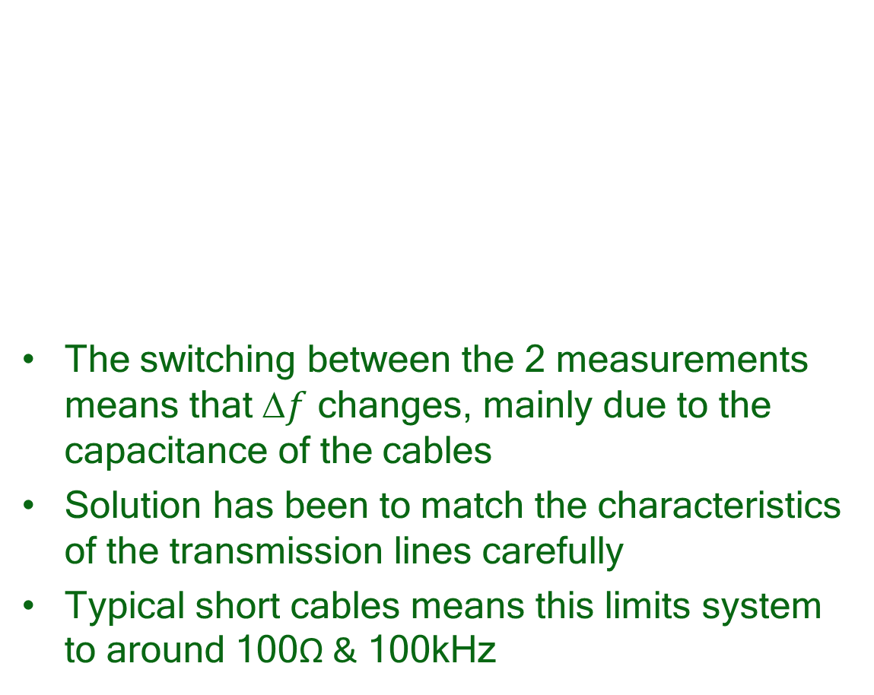
Prior Art Johnson Noise Thermometer
The switching between the 2 measurements means that $f$ changes, mainly due to the capacitance of the cables
Solution has been to match the characteristics of the transmission lines carefully
Typical short cables means this limits system to around 100Ω & 100kHz
An innovation project by ……
Notes:
However, the noise in the two measurements will not experience exactly the same bandwidth, due to the difference in the characteristics of the connecting cables (capacitance problem).
Any switching system experiences this problem. Historically, this has been mitigated by limiting the bandwidth to around 100kHz for a 100Ω sensor. The limited signal bandwidth leads to long integration times and therefore slow response time (many minutes).

Slide 11
Metrosol Johnson Noise Thermometer
Calibration signal injected as current, which generates a calibration voltage in the sensor
The Johnson noise & calibration signal experience the same frequency response
The signals are subsequently separated completely using digital signal processing
An innovation project by ……
Notes:
Our new technique (patented) is to inject the calibration signal as a current into the measurement system, which generates a calibration voltage signal in the resistor.
The Johnson Noise and calibration signal experience EXACTLY the same frequency response. The Johnson noise and calibration signal are then separated using digital signal processing (DSP).

Slide 12
Metrosol Johnson Noise Thermometer
Transmission line connecting PRN current source to sense resistor will attenuate higher frequency components of calibration current signal
Connecting current source directly to sense resistor will cause unacceptable measurement uncertainty
An innovation project by ……
Notes:
A potential problem with this new technique is that any transmission line connecting the current calibration signal to the sensor will itself have a frequency response that affects the calibrations signal but not the Johnson noise.

Slide 13

Metrosol Johnson Noise Thermometer
Injecting calibration signal at centre:
measured signal power $=V_{C}\left(1−x\right){.V}_{C}\left(1−x\right)$.
Injecting calibration signal at “A”:
measured signal power $=V_{C}.V_{C}{\left(1−x\right)}^{2}$
There appears to be a cancellation of the error, but the model is grossly oversimplified
An innovation project by ……
Notes:
However, if the current calibration signal is instead connected to the input of one of the pre-amplifiers (which is easier to do anyway since the electronics are all in the sensor head), this problem appears to be resolved. The calibration signal at Amplifier A input is higher than if it had been injected perfectly at the sensor resistance since it is not attenuated by a transmission line. But the calibration signal at amplifier B input is lower having experienced the frequency response of two transmission lines. The net effect is that the product of the two signals (i.e. the correlated signal) is the same as if the calibration current signal had been injected directly into the sense resistor.

Slide 14
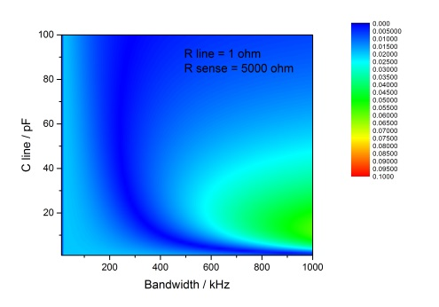
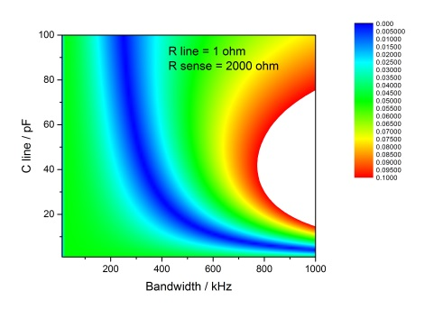
Metrosol Johnson Noise Thermometer
Sensitivity analysis of full model shows that errors are small for higher values of sense resistor – which is what we want in the JNT!
An innovation project by ……
Notes:
Of course, things are a little more complicated that this simple analysis. A full mathematical model of the system was therefore developed to look at errors in the measurement system due to the transmission lines and the injection point. The graphs above show the resulting errors (blue being low errors, increasing to red for high errors). The graphs show the errors for a range of bandwidths (x-axis) and cable capacitance (y-axis) for a transmission line with 1Ω resistance (so conservative). We need to operate in a dark blue part of the operating parameters.
The graph on the right is for a 2kΩ sense resistor and provides a limited range in which the system must operate. The graph on the left is for a 5kΩ, which shows a much wider operating range. Unlike the prior art, the errors from circuit imperfections/limitations get better at as the sense resistance increases. A high sense resistance provides more Johnson noise thereby making the measurement easier.

Slide 15
Signal Improvement
Prior Art | Metrosol JNT | Improvement
100Ω | 5kΩ | x50
100kHz | 1MHz | x10
Switching | No Switching | x2
 |  | TOTAL = x1000
Notes:
By being able to use a higher sense resistance (5kΩ instead of 100Ω) and higher bandwidth (1MHz instead of 100kHz) and also eliminating the need to switch between 2 measurements, the signal available with our system is about 1,000 times more than with the prior art systems. The consequent increase in performance is a “game changer” and has been key to realising a practical JNT.

Slide 16
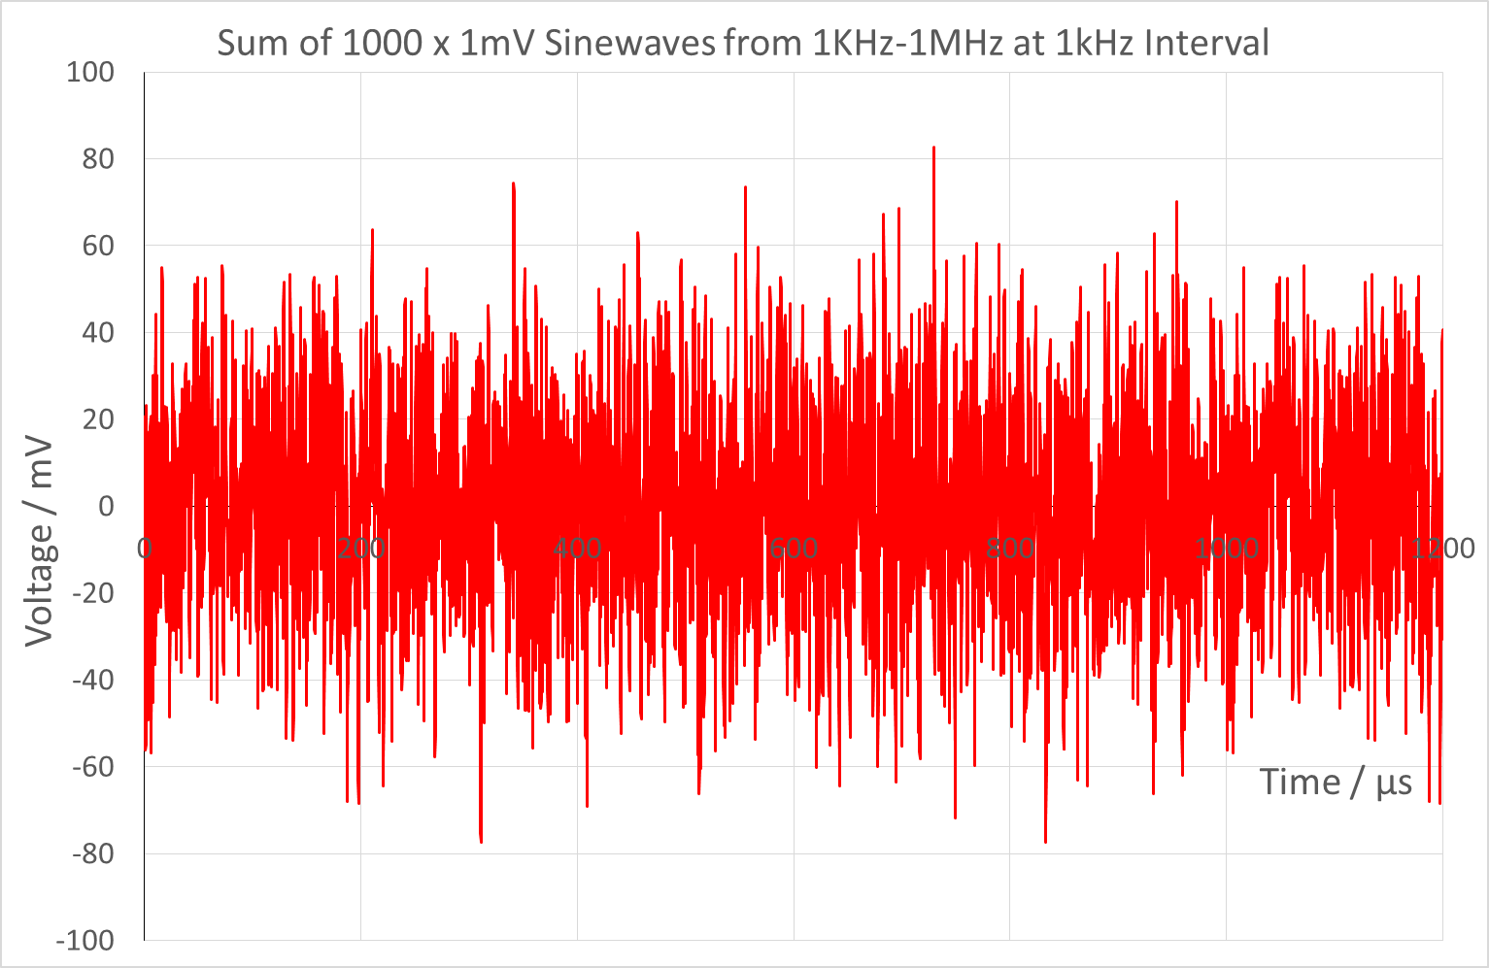
Pseudo Random Noise Calibration Signal
Notes:
The PRN (pseudo-random noise) calibration signal comprises comb of equally spaced tones with randomised phase. The time domain signal looks and indeed is a gaussian noise signal, but one that repeats at the fundamental frequency of the harmonically related tones. In the above trace, it is clear that the signal repeats after 1000μs (as a result of the 1kHz fundamental).

Slide 17
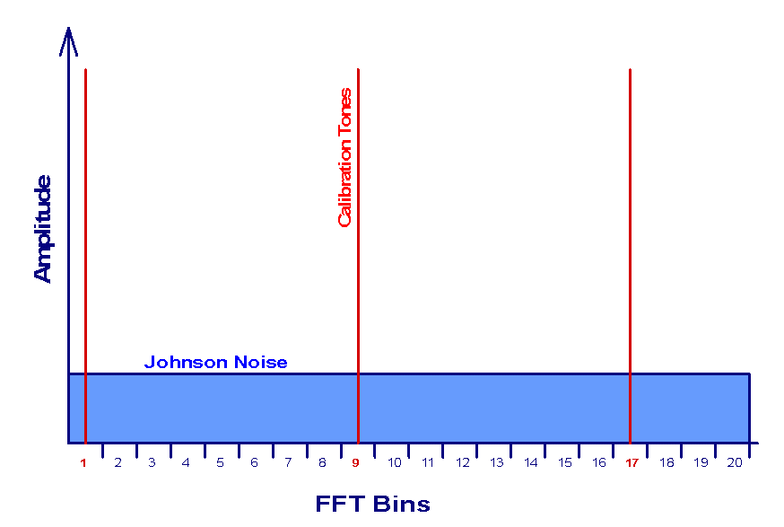
Pseudo Random Noise Calibration Signal
Notes:
In the frequency domain, the tones are arranged to be central in each of the bins of the FFT (Fast Fourier Transform) used in the correlator. This ensures there is no leakage of the tone signals into adjacent bins and allows the calibration signal and Johnson noise to be completely separated using DSP. The Johnson noise can be determined using only bins that do not contain a tone. The calibration signal can be determined using the FFT bins containing a tone and then subtracting (in quadrature since it is uncorrelated) the Johnson noise already determined.

Slide 18
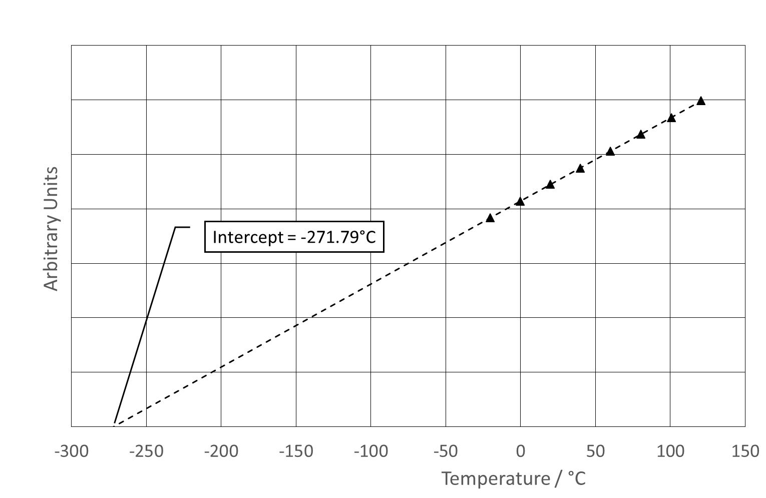
Results = Linearity & Offset
Notes:
Our initial results showed that the noise power measured in arbitrary units in the vertical scale behave as expected. There is a linear variation with temperature and the extrapolated line intercepts the x axis close to absolute zero. In this first experiments the intercept was at -271.79 degrees C and the error of 1.36 kelvin is within our expected uncertainty bearing in mind the length of the extrapolation.

Slide 19
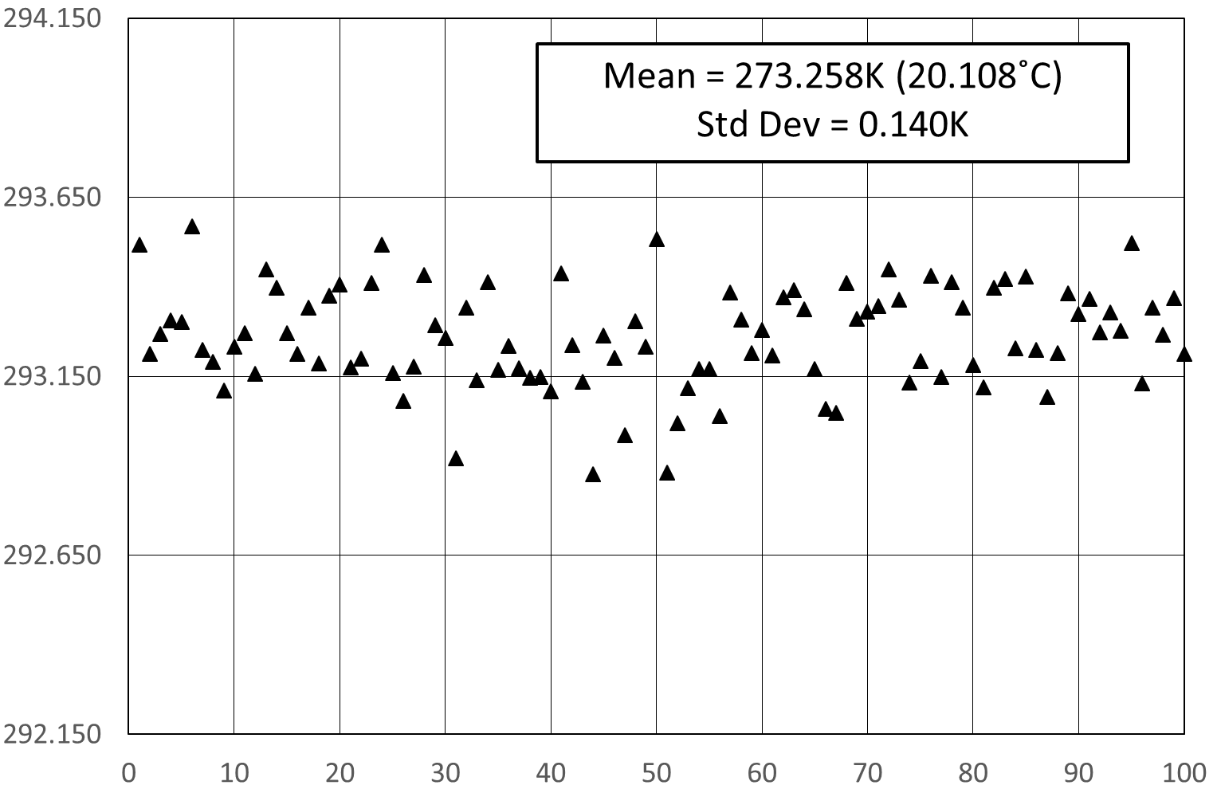
Results: Accuracy
Notes:
We then calibrated the electronics against electrical standards and measured a resistor maintained at 20 degree Celsius in a oil bath to achieve these results. These measurements are actually 6.55 second samples but spaced out over a period of 3 days. The standard deviation of the error is 0.14 °C

Slide 20
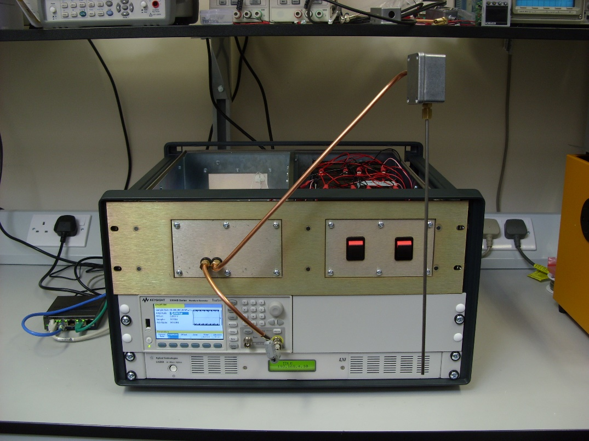
Progress So Far
Proof of principal prototype, working in normal laboratory environment:
Notes:
The proof of principle demonstrator proved the viability of the technique whilst operating in a normal laboratory environment (electrically noise but not as harsh as some industrial environments). It was built into a 6U 19” rack (70L and 35kg) and used several commercial instruments.

Slide 21
An innovation project by…
For more information, visit….
Prototype on Isotech stand here
Or…
www.johnson-noise-thermometer.com
Metrosol Limited

